Slide 1
ACM Code of Ethics and Professional Conduct
Part 2
PROFESSIONAL LEADERSHIP PRINCIPLES
COMPLIANCE WITH THE CODE.

Slide 2
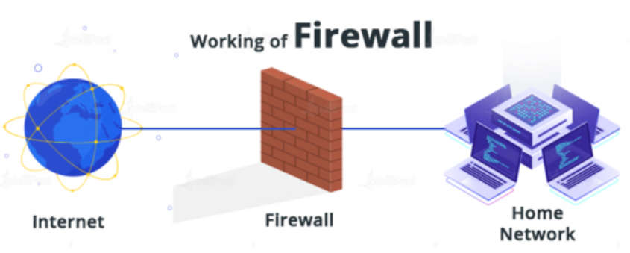
PROFESSIONAL LEADERSHIP PRINCIPLES
Leadership may either be a formal designation or arise informally from influence over others.
In this this context, "leader" means any member of an organization or group who has influence, educational responsibilities, or managerial responsibilities.
While these principles apply to all computing professionals, leaders bear a heightened responsibility to uphold and promote them, both within and through their organizations.

Slide 3
PROFESSIONAL LEADERSHIP PRINCIPLES
A computing professional, especially one acting as a leader, should…
1) Ensure that the public good is the central concern during all professional computing work
People—including users, customers, colleagues, and others affected directly or indirectly—should always be the central concern in computing.
The public good should always be an explicit consideration when evaluating tasks associated with research, requirements analysis, design, implementation, testing, validation, deployment, maintenance, retirement, and disposal.
Computing professionals should keep this focus no matter which methodologies or techniques they use in their practice.

Slide 4
PROFESSIONAL LEADERSHIP PRINCIPLES
A computing professional, especially one acting as a leader, should…
2) Articulate, encourage acceptance of, and evaluate fulfillment of social responsibilities by members of the organization or group
Technical organizations and groups affect broader society, and their leaders should accept the associated responsibilities.
Organizations—through procedures and attitudes oriented toward quality, transparency, and the welfare of society—reduce harm to the public and raise awareness of the influence of technology in our lives.
Therefore, leaders should encourage full participation of computing professionals in meeting relevant social responsibilities and discourage tendencies to do otherwise.

Slide 5
PROFESSIONAL LEADERSHIP PRINCIPLES
A computing professional, especially one acting as a leader, should…
3) Manage personnel and resources to enhance the quality of working life
Leaders should ensure that they enhance, not degrade, the quality of working life.
Leaders should consider the personal and professional development, accessibility requirements, physical safety, psychological well-being, and human dignity of all workers.
Appropriate human-computer ergonomic* standards should be used in the workplace.
*ergonomic (adjective): relating to or designed for efficiency and comfort in the working environment.

Slide 6
PROFESSIONAL LEADERSHIP PRINCIPLES
A computing professional, especially one acting as a leader, should…
4) Articulate, apply, and support policies and processes that reflect the principles of the Code
Leaders should pursue clearly defined organizational policies that are consistent with the Code and effectively communicate them to relevant stakeholders.
In addition, leaders should encourage and reward compliance with those policies, and take appropriate action when policies are violated.
Designing or implementing processes that deliberately or negligently violate, or tend to enable the violation of, the Code's principles is ethically unacceptable.

Slide 7
PROFESSIONAL LEADERSHIP PRINCIPLES
A computing professional, especially one acting as a leader, should…
5) Create opportunities for members of the organization or group to grow as professionals
Leaders should ensure that opportunities are available to computing professionals to help them improve their knowledge and skills in professionalism, in the practice of ethics, and in their technical specialties.
These opportunities should include experiences that familiarize computing professionals with the consequences and limitations of particular types of systems.
Computing professionals should be fully aware of the dangers of oversimplified approaches, the inevitability of software errors, the interactions of systems and their contexts, and other issues related to the complexity of their profession—and thus be confident in taking on responsibilities for the work that they do.

Slide 8
PROFESSIONAL LEADERSHIP PRINCIPLES
A computing professional, especially one acting as a leader, should…
6) Use care when modifying or retiring systems
Interface changes, the removal of features, and even software updates have an impact on the productivity of users and the quality of their work.
Leaders should take care when changing or discontinuing support for system features on which people still depend.
Leaders should thoroughly investigate viable alternatives to removing support for a legacy system.
If these alternatives are unacceptably risky or impractical, the developer should assist stakeholders' graceful migration from the system to an alternative.
Users should be notified of the risks of continued use of the unsupported system long before support ends.

Slide 9
PROFESSIONAL LEADERSHIP PRINCIPLES
A computing professional, especially one acting as a leader, should…
7) Recognize and take special care of systems that become integrated into the infrastructure of society
Even the simplest computer systems have the potential to impact all aspects of society when integrated with everyday activities such as commerce, travel, government, healthcare, and education.
When organizations and groups develop systems that become an important part of the infrastructure of society, their leaders have an added responsibility to be good stewards of these systems.
Part of that stewardship requires establishing policies for fair system access, including for those who may have been excluded.
That stewardship also requires that computing professionals monitor the level of integration of their systems into the infrastructure of society.
Continual monitoring of how society is using a system will allow the organization or group to remain consistent with their ethical obligations outlined in the Code.

Slide 10
COMPLIANCE WITH THE CODE
A computing professional should…
1) Uphold, promote, and respect the principles of the Code
The future of computing depends on both technical and ethical excellence.
Computing professionals should adhere to the principles of the Code and contribute to improving them.
Computing professionals who recognize breaches of the Code should take actions to resolve the ethical issues they recognize, including, when reasonable, expressing their concern to the person or persons thought to be violating the Code.

Slide 11
COMPLIANCE WITH THE CODE
A computing professional should…
2) Treat violations of the Code as inconsistent with membership in the ACM
Each ACM member should encourage and support adherence by all computing professionals regardless of ACM membership.
ACM members who recognize a breach of the Code should consider reporting the violation to the ACM, which may result in remedial action as specified in the ACM's Code of Ethics and Professional Conduct Enforcement Policy*.
* ACM Code of Ethics Enforcement Procedures
https://www.acm.org/code-of-ethics/enforcement-procedures

Slide 12
Case Study Analysis
John, a software engineer at a prominent tech company, discovers a critical security vulnerability in the company's product just days before a major release. The release date is non-negotiable due to contractual commitments. John's manager insists on ignoring the issue to meet the deadline. John is torn between adhering to ACM's Code of Ethics and Professional Conduct, which emphasizes the importance of public safety, and meeting the company's commitments.
Analytical Questions:
What ethical principles from the ACM Code of Ethics and Professional Conduct apply to this case?
What are the potential consequences of ignoring the security vulnerability, both for the public and for John's professional integrity?
How can John effectively communicate his concerns to his manager and the team while balancing the need to meet the release deadline?

Slide 13
Case Study Analysis
Sample Answers:
Q) What ethical principles from the ACM Code of Ethics and Professional Conduct apply to this case?
Several ethical principles from the ACM Code of Ethics apply to this case, including:
Public Good: The principle of ensuring the public good and safety is paramount. John has a responsibility to address the security vulnerability to prevent potential harm to users.
Professional Integrity: John must uphold the highest level of professional integrity and not compromise his ethical standards, even under pressure.
Honesty and Transparency: He should be honest about the issue and transparently communicate the risks involved.

Slide 14
Case Study Analysis
Sample Answers:
Q) What are the potential consequences of ignoring the security vulnerability, both for the public and for John's professional integrity?
Ignoring the security vulnerability can have severe consequences:
Public Safety: Users of the product may be exposed to security threats, leading to data breaches or other forms of harm.
Legal Ramifications: The company may face legal consequences if harm occurs due to the known vulnerability.
Professional Integrity: John's professional integrity could be compromised, potentially harming his career in the long run. He might also face ethical violations according to ACM's Code.

Slide 15
Case Study Analysis
Sample Answers:
Q) How can John effectively communicate his concerns to his manager and the team while balancing the need to meet the release deadline?
John can take the following steps:
Document the Issue: Gather evidence of the security vulnerability and its potential impact.
Prepare a Detailed Report: Create a comprehensive report outlining the issue, potential risks, and recommended solutions.
Engage in Open Dialogue: Have a candid conversation with his manager, emphasizing the importance of addressing the vulnerability for the sake of the public and the company's reputation.
Propose Mitigation Strategies: Suggest alternative strategies to meet the deadline without compromising security, such as releasing a patch immediately after the main release.
Involve Higher Authorities: If the manager is unresponsive, escalate the matter to higher management or an internal ethics committee, if available, to ensure ethical standards are maintained.
Seek Legal Protections: Depending on jurisdiction, there may be legal protections for whistleblowers who raise concerns about ethical or legal violations within their organizations. John should consult with legal counsel if necessary.

Slide 16
References
https://www.acm.org/code-of-ethics

